Slide 1
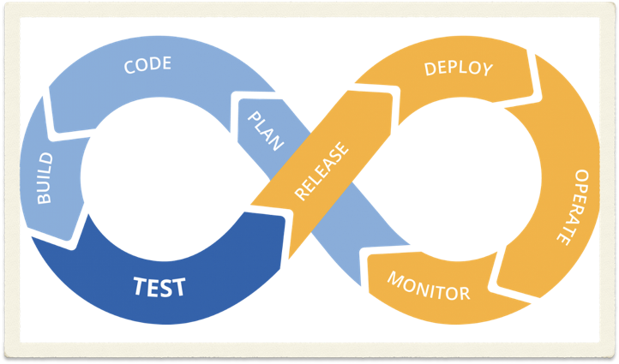
Continuous integration
and continuous deployment
With Travis
李翌珺、宋逸凡

Slide 2

What is CI/CD?
Continuous Integration is the practice of integrating code into a shared repository and building/testing each change automatically, as early as possible - usually several times a day.
Continuous Delivery adds that the software can be released to production at any time, often by automatically pushing changes to a staging system.
Continuous Deployment goes further and pushes changes to production automatically.

Slide 3
Hot CI/CD tools
Jenkins
ElectricFlow
Octopus Deploy
DeployBot
TeamCity
CircleCI
…
Source: <<21 Automated Deployment Tools You Should Know>> from DevOps Zone-Opinion Mar. 15, 17

Slide 4
Hands-on practice
with Travis
——-Continuous Integration

Slide 5

Prerequisites
GitHub login
Project hosted as a repository on GitHub
Working code in your project
Working build or test script

Slide 6
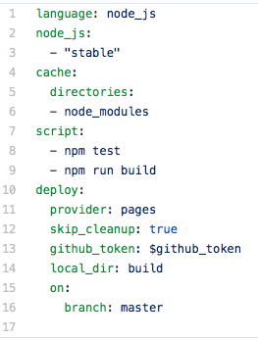
Enable the repository you want to build
Add a .travis.yml file to your repository to tell Travis CI what to do.
Add the .travis.yml file to git, commit and push, to trigger a Travis CI build
Make some changes to code

Slide 7
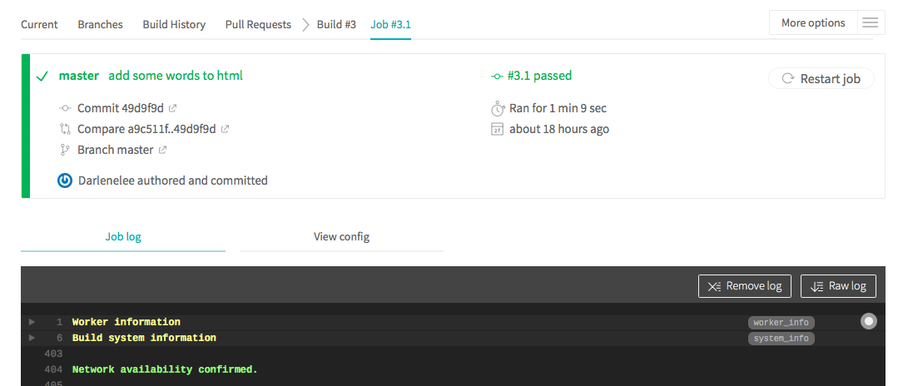

Slide 8
Security Issues
Github_token configuration
Github settings > developer settings > personal access tokens > generate new token
TravisCI settings > environmental variables

Slide 10

Add an icon to your repo:
[![Build Status](https://travis-ci.org/githubid/reponame.svg?branch=master)](https://travis-ci.org/githubid/reponame)

Slide 11
Hands-on practice
with Travis/Github Pages
——-Continuous Deployment

Slide 12

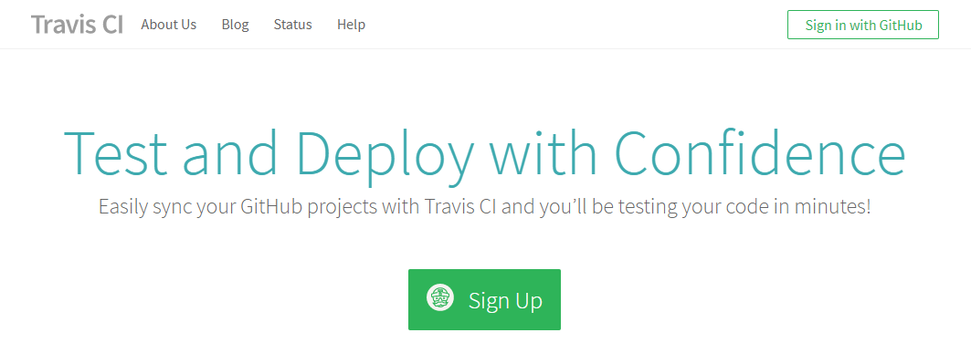
Prerequisites
Sign in at Travis CI with GitHub

Slide 13
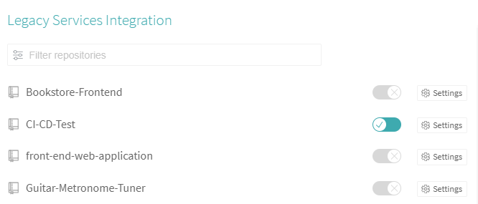
Prerequisites
Open the trigger of the project.

Slide 14
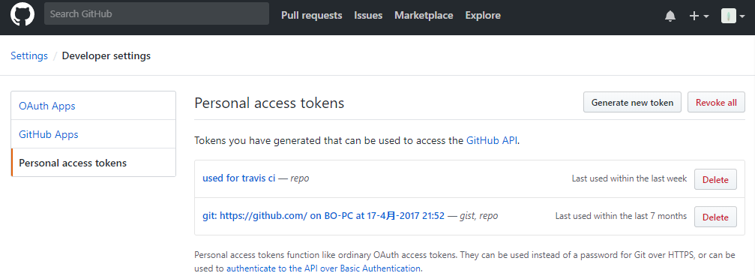
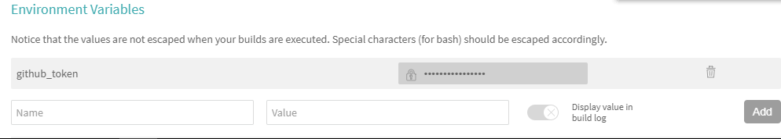
Prerequisites
Get the Personal access tokens git and add it to travis repo's Environment Variables

Slide 15
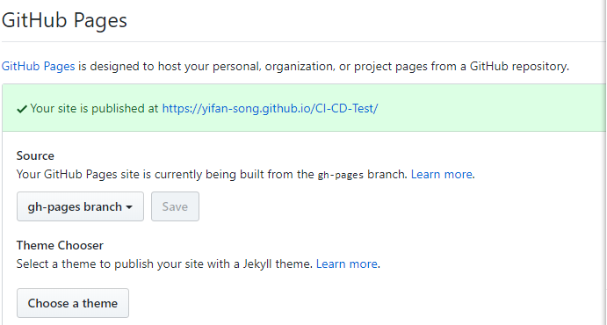
Prerequisites
Get the GitHub Pages Site of the project

Slide 16
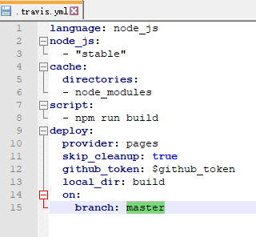
Add a .travis.yml file to your repository to tell Travis what to do.
Notice: github_token variable need to be assigned with your github's Personal access token.

Slide 17
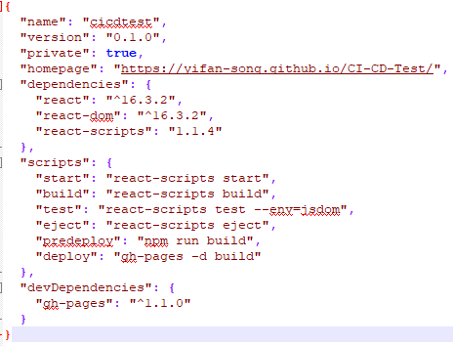
Make some change to package.json file:
Add homapage variable with your repo's github pages.
Add predeploy、deploy、devDependcies variables
Add the file to git, commit and push, to trigger a Travis CI&CD build

Slide 18
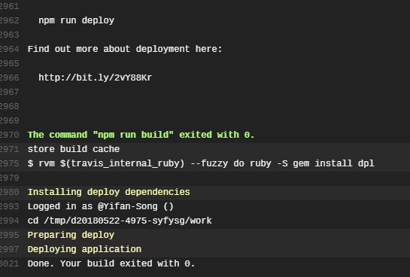
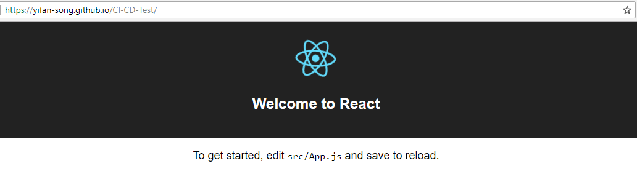
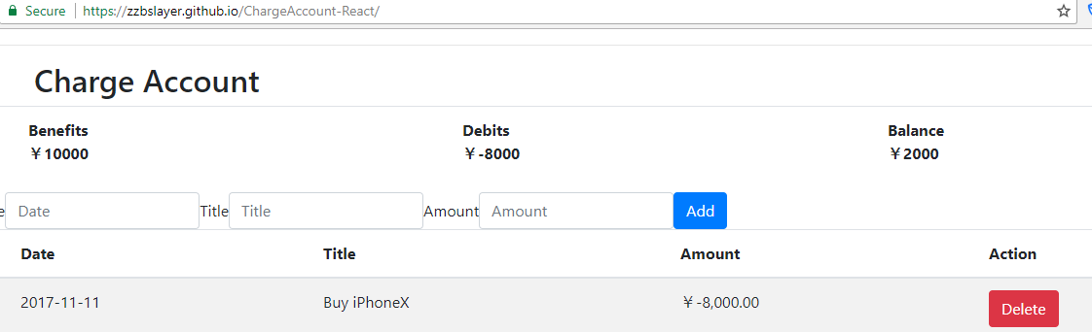
After Travis CI finish build, we can view our project at the github pages:

Slide 19
Conclude
Travis-ci is a free cloud service. Private repo CI service is charging. Thus we can choose to build our own CI platform with Jenkins or drone.
Similarly, our CD is currently deployed on the Heroku server or github pages. In actual production, we should use puppet or some other tools to deploy the project on our own server.

Slide 20
Thanks！

